Slide 1
L E C T U R E
8
SOFTWARE PROJECT PLANNING
Notes:
This repository of slides is intended to support the named chapter. The slide repository should be used as follows:
Copy the file to a unique name for your course and unit.
Edit the file by deleting those slides you don’t want to cover, editing other slides as appropriate to your course, and adding slides as desired.
Print the slides to produce transparency masters or print directly to film or present the slides using a computer image projector.
Each slide includes instructor notes. To view those notes in PowerPoint, click-left on the View Menu; then click left on Notes View sub-menu. You may need to scroll down to see the instructor notes.
The instructor notes are also available in hardcopy as the Instructor Guide to Accompany Systems Analysis and Design Methods, 5/ed.

Slide 2
The Software Equation
The software equation [PUT92] is a dynamic multivariable model that assumes a specific distribution of effort over the life of a software development project. The model has been derived from productivity data collected for over 4000 contemporary software projects. Based on these data, an estimation model of the form
https://www.easycalculation.com/other/software-equation.php
E= ( (Loc × B^{(1 / 3)})/P )³ × (1 / t⁴)

Slide 3
Where
E = effort in person-months or person-years
t = project duration in months or years
B = “special skills factor”
P = “productivity parameter” that reflects:
Typical values might be P = 2,000 for development of real-time embedded software;
P = 10,000 for telecommunication and systems software;
P = 28,000 for business systems applications.
The productivity parameter can be derived for local conditions using historical data collected from past development efforts.
It is important to note that the software equation has two independent parameters: (1) an estimate of size (in LOC) and (2) an indication of project duration in calendar
months or years.
Explain different feature of Software Equation
(Book, Page-no -135 read details)

Slide 4
THE MAKE/BUY DECISION
The following guidelines can be applied:
1. Develop specifications for function and performance of the desired software. Define measurable characteristics whenever possible.
2. Estimate the internal cost to develop and the delivery date.
3a. Select three or four candidate applications that best meet your specifications.
3b. Select reusable software components that will assist in constructing the required application.
4. Develop a comparison matrix that presents a head-to-head comparison of key
functions. Alternatively, conduct benchmark tests to compare candidate software.
5. Evaluate each software package or component based on past product quality,
vendor support, product direction, reputation, and the like.
6. Contact other users of the software and ask for opinions.

Slide 5
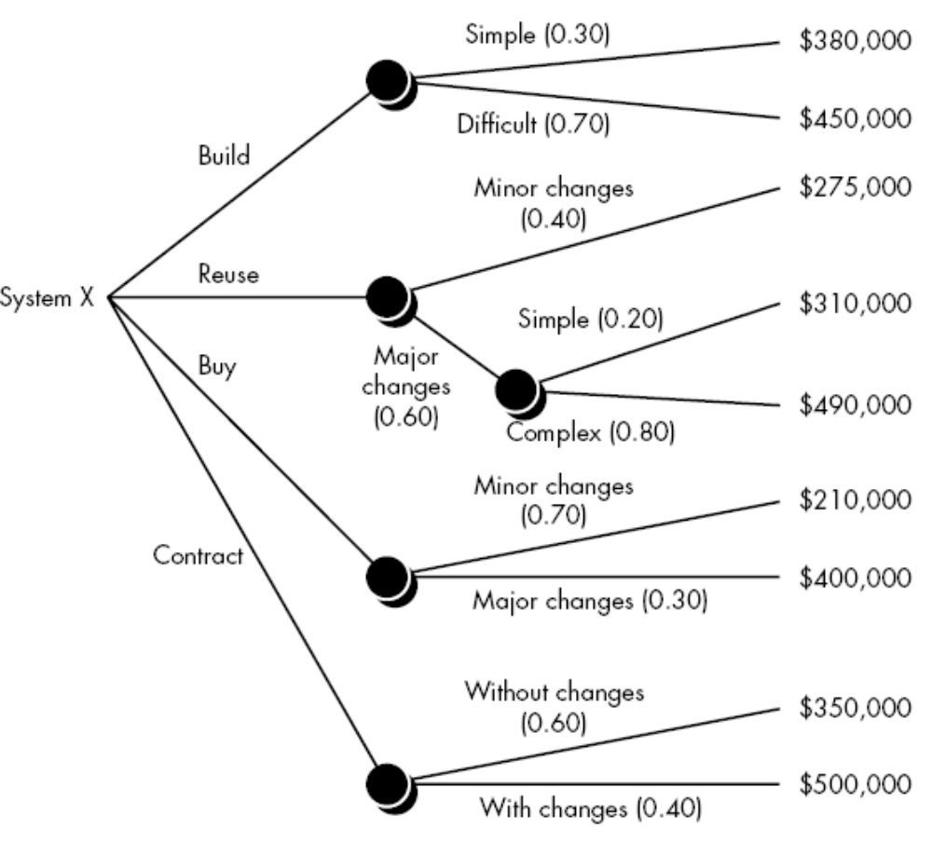
A decision tree to support the
make/buy decision

Slide 6
AUTOMATED ESTIMATION TOOLS
Although many automated estimation tools exist, all exhibit the same general characteristics and all perform the following six generic functions
1. Sizing of project deliverables.
2. Selecting project activities.
3. Predicting staffing levels.
4. Predicting software effort.
5. Predicting software cost.
6. Predicting software schedules.

